Slide 1
The Third Seal: The Black Horse of Inflation – Part II
Prof. Tom Mack, B.A., Morningside College, M.B.A., The University of South Dakota, A+ and Net+ Certifications, Computing Technology Industry Association
Maj. (ret.) Tom Baird, B.S., Michigan State University, M.B.A., Georgia State University

Slide 2
The Four Horsemen of the Apocalypse
The White Horse –
The “Bow” – toxon – Deliberate Poisoning of the World using Cobra and Krait venom.
The “Crown” – stephanos – False measures by quasi-government authorities promising to curb the damage from this poisoning.

Slide 3
The Four Horsemen of the Apocalypse
The Red Horse –
Deliberate incitement of war by the Royal Families (who control the World Economic Forum and their cronies). (e.g., the Russia-Ukraine War)
Massive Inflation due to the debasement of currencies caused by both the poisoning of the world and the need by the Royal Families to fund Ukraine’s war effort.

Slide 4
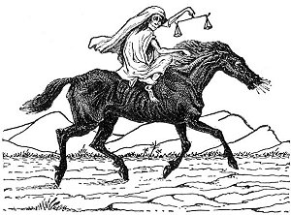
The Third Seal – The Black Horse
And when he had opened the third seal, I heard the third beast (the face of a man) say, Come and see. And I beheld, and lo a black horse; and he that sat on him had a pair of balances in his hand.
And I heard a voice in the midst of the four beasts say, “A measure of wheat for a penny, and three measures of barley for a penny; and see thou hurt not the oil and the wine.” (Revelation 6:5-6)

Slide 5
Inflation and How It Affects Your Life
Can this Monster be Tamed?

Slide 6
Understanding Inflation
While many economists claim to have the perfect definition for inflation, most of them will agree with this statement:
Inflation is the increase in the quantity of money that is not offset by a corresponding increase in the value of goods and services created by that nation (Called the Gross Domestic Product (GDP) but in times past called the Gross National Product (GNP)), price inflation will necessarily follow, always leaving a poorer nation.

Slide 7
Understanding Inflation
Traditionally, the Federal Reserve Banks measured the total supply of money in the United States economy using what we called the M3 - Monetary Aggregate.
However, on March 23, 2006, the Board of Governors ceased publishing this figure.
Without this figure, we have no effective way to measure inflation.
The recent publication of an 8.2% inflation rate is based upon the cost of a “basket” of goods and services. Click here to download report for June 10, 2022. U.S. Government Link

Slide 8
The Rise in the Russian Ruble
Right now, the Russian Ruble is rising against all other currencies because Russian companies and banks will NOT accept foreign currencies in payment for Russian goods like oil, natural gas, and now, other Russian commodities. Because of this:
The demand for Euros, Dollars, Pounds, and Swiss Francs has decreased while the demand for Russian Rubles has increased.
Despite this disparity, the European Union has gone ahead with a sixth round of sanctions!

Slide 9
The Russian Policy
Russian president Vladimir Putin shocked the world when he started following the Austrian Economic Theories of Ludwig von Mises and pegged the value of the Russian Ruble to gold.
The Austrian School suggests that pegging your currency to gold will control inflation and keep the money supply in check.
It is interesting that the Russian Central Bank rarely intervenes in the Russian Economy while the European Union, Great Britain, and the Federal Reserve frequently intervene in their economies.

Slide 10
The Russian Policy
Russian president Vladimir Putin shocked the world when he started following the Austrian Economic Theories of Ludwig von Mises and pegged the value of the Russian Ruble to gold.
Recently, Russia shocked the world when its central bank started lowering its prime interest rate.
It started the year at 20% but with the rise in the strength of the Ruble, they have systematically lowered that rate to 7.5%! Still, the one dollar is worth 56.78 Rubles. The Russians would prefer the exchange rate to be 65 Rubles to the dollar.
The Russian Central Bank is threatening to lower its prime interest rates even more so the Ruble will not rise against foreign currencies too much.

Slide 11
The Russian Policy
How can the Russian Central Bank succeed in raising their prime interest rate to 20% without crashing their economy?
Unlike the Federal Reserve Banks in the United States, the Russians started paying off their national debt when President Putin took office in 1999. To pay off their Western Bankers, he put his country through a lot of financial stress in the first decade of the 21st century.
By 2010, the Russian Federation had essentially paid off their national debt. Because of that, their Central Bank is free to use their prime interest rate to maintain control over monetary inflation.
When the European Union and the USA tried to sanction Russia, their Central Bank was able to raise interest rates to 20% to control monetary inflation.

Slide 12
The Russian Policy
Why can the Russian Central Bank raise their Prime Interest Rate to 20% with repercussions, but if the Federal Reserve tried to raise interest rates that high, it would crash our economy… why can Russia do it and the United States can’t?
The U.S. National Debt is over $30,528,000,000,000. Interest on the National Debt, based upon the Prime Interest Rate of 4.75% is $1,450,080,000,000. The Gross Domestic Product for the USA is $20,953,000,000,000. If the Federal Reserve were to raise the Prime Interest Rate to its record high in December of 1980 of 21.50%, the Annual Interest on the national debt would be $6,563,520,000,000 or about 30% of GDP.
The more interest the U.S. Government pays to the Federal Reserve, the greater the stress on our economy.
Right now, the U.S. Government is technically in a state of insolvency.

Slide 13
The Russian Policy
Russian president Vladimir Putin has Battled the U.S. and E.U. Sanctions Using the Following Measures:
Russia now ships much of their oil on Greek oil tankers through Greece to India and China. The Greek shipping magnates collect fees on every transport they broker.
The European Union cannot stop them because the shipping magnates control the Greek government.
Russian Insurance Companies now write most of the insurance on the tankers, leaving Lloyds of London (a British Insurance Company) out of the transaction.

Slide 14
The Russian Policy
Implications of Russian Policy:
When the crude oil is shipped to India, they will refine the Russian oil into gasoline and other oil products.
These products will then be resold back to the European Union and Great Britain at considerably higher prices.

Slide 15
The Defense Industries Compared
The United States
Russian Federation
Lockheed-Martin (LMT)
Raytheon Technologies (RTX)
Boeing Aircraft (BA)
Northrup-Grumman (Private)
General Dynamics (GD)
BAE Systems (British-owned with American Subsidiaries)
L3 Harris Technologies (LHX)
Huntington-Ingalls (HII)
Leidos (LDOS) formerly SAI Corp.
Honeywell (HON)
Almaz-Antley Corporation
United Aircraft Corporation
Tactical Missiles Corporation
Russian Helicopters
Uralvagonzavod (Battle Tanks)
United Shipbuilding Corporation
All these Russian Corporations are state-owned, but they do sell their products to other countries, with appropriate governmental approvals.

Slide 16
What is the Difference Between USA Defense Industries and Their Russian Counterpart Industries?
The Department of Defense (DoD) Develops Product Specifications and Then, They Send Those Specifications Out for Bidding. The Company With the Lowest Bid Gets the Contract.
Companies are Free to Develop Products They Think Might be Useful to the DoD, but the DoD reserves the Right to Accept or Reject These Products.
Russian State Industries are Operated as Non-Profit Corporations. They are NOT Taxed! They are Incentivized to Develop Products.

Slide 17
Inflation in History
“History teaches us that man learns nothing from history.”
Georg Wilhelm Friedrich Hegel
What can we learn from history that will teach us how to deal with the future?

Slide 18
Biblical History
And there was no bread in all the land; for the famine was very sore, so that the land of Egypt and all the land of Canaan fainted by reason of the famine.
And Joseph gathered up all the money that was found in the land of Egypt, and in the land of Canaan, for the corn (grain) which they bought: and Joseph brought the money into Pharaoh's house.
And when money failed in the land of Egypt, and in the land of Canaan, all the Egyptians came unto Joseph, and said, Give us bread: for why should we die in thy presence? for the money faileth. (Genesis 47:13-15)

Slide 19
Biblical History
Joseph solved the currency problem in Egypt by buying the people’s goods in exchange for their currency.
Because of the famine situation, Egypt’s Gross Domestic Product (GDP) continued to drop, therefore, the people did not generate a profit with their labors. Therefore, they did not earn any new currency.
Joseph’s long-term goal was to enslave all the people (especially the Israelites) to Pharoah creating political conditions which would cause the Israelites to return to Canaan.

Slide 20
The Biblical Solution
Leviticus 25 and Deuteronomy 15 outline two economic measures that will curb monetary inflation:
The Sabbath Year (verses 1 - 7)
Cultivate your fields for six years and rest the land in the seventh.
Gather fruit off the vines for six years and in the seventh year, leave the fruit on the vine.
All debts shall be cancelled every seven years (Deuteronomy 15:1-23)

Slide 21
The Biblical Solution
Leviticus 25 and Deuteronomy 15 outline two economic measures that will curb monetary inflation:
The Jubilee Year (verses 8 - 34)
On Yom Kipper of the 50th year, all lands are redeemed back to their original families.
The fields are NOT to be sown but you can eat from the “volunteer” plants that do grow in the field.

Slide 22
The Biblical Solution
Applying the Biblical Solution to an Economy will correct the following problems:
Curb the Growth of Money (Inflation) in an Economy.
Ensure that the land does not end up in the hands of a few oligarchs, who then use that influence to control the mechanisms of government.

Slide 23
The Biblical Solution
The Bible Also Places Controls on Kings:
When thou art come unto the land which YHWH thy Elohim giveth thee, and shalt possess it, and shalt dwell therein, and shalt say, I will set a king over me, like as all the nations that are about me;
Thou shalt in any wise set him king over thee, whom YHWH thy Elohim shall choose: one from among thy brethren shalt thou set king over thee: thou mayest not set a stranger over thee, which is not thy brother. (Deuteronomy 17:14-15)
This is where our Founding Fathers got the idea for this constitutional requirement:
No Person except a natural born Citizen, or a Citizen of the United States, at the time of the Adoption of this Constitution, shall be eligible to the Office of President… (Article V, §1, Clause 5)

Slide 24
The Biblical Solution
The Bible Also Places Controls on Kings:
But he shall not multiply horses to himself, nor cause the people to return to Egypt, to the end that he should multiply horses: forasmuch as YHWH hath said unto you, Ye shall henceforth return no more that way.
Neither shall he multiply wives to himself, that his heart turn not away: neither shall he greatly multiply to himself silver and gold. (Deuteronomy 17:16-17)
These verses limit the wealth of an Israelite king, but also what foreign trade a king can engage in to enhance his wealth.
How many of these conditions did the Kings of Israel violate?

Slide 25
The Biblical Solution
The Bible Also Places Controls on Kings:
And it shall be, when he sitteth upon the throne of his kingdom, that he shall write him a copy of this law in a book out of that which is before the priests the Levites:
And it shall be with him, and he shall read therein all the days of his life: that he may learn to fear YHWH his Elohim, to keep all the words of this law and these statutes, to do them: (Deuteronomy 17:18-19)
When children who are in the kingly line reach an age where they can learn to read and write, they would start writing out their copy of the Torah. Their work would be supervised by designated scribes and Torah teachers.

Slide 26
The Biblical Solution
The Bible Also Places Controls on Kings:
That his heart be not lifted up above his brethren, and that he turn not aside from the commandment, to the right hand, or to the left: to the end that he may prolong his days in his kingdom, he, and his children, in the midst of Israel. (Deuteronomy 17:20)
Notice, the Torah does not make provision for a female ruler, however, we know that Bathsheba, Solomon’s mother did sit at Solomon’s side as queen. (I Kings 2:19) Also, King Asa’s mother ruled as queen until Asa found out that she had made an idol in a grove. Asa personally dispatched the idol, burning it in the brook Kidron. (II Chronicles 15:16)
The king must always rule as the Torah specifies. If he does, he will rule for a long time.

Slide 27
Economic History of Inflation
Has Inflation Been a Problem in the Past?

Slide 28
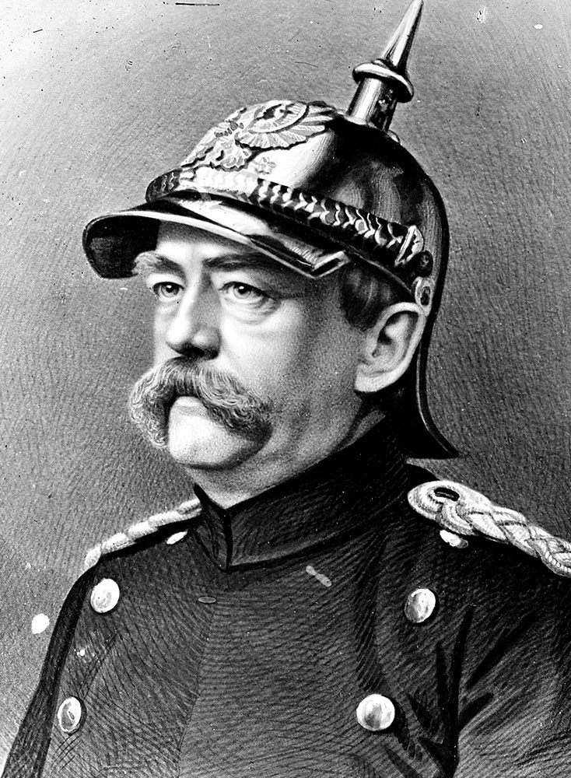
Pre-World War I Economics
Germany having unified in 1870, was suffered “growing pains” integrating 40+ nations into one government.
The Depression of 1873 hurt the economies of Europe and caused Germany to become the world’s first “Welfare State.”
Otto von Bismarck did a masterful job of national building and keeping Europe out of a world war.
He would remain in power until 1890 when he continually clashed with Kaiser Wilhelm II over several social issues and over German expansionism.

Slide 29
Pre-World War I Economics
The Problem with the “Welfare State” of Germany was that it tapped the national budget, causing deficits.
Germany tried to expand is colonies, hoping that they could enhance their economies at home. They tried to extract the raw materials from their colonies to employ in their vast manufacturing apparatus in the Ruhr Valley and in Bavaria. The accumulated wealth would finance their “Welfare State.”
Unfortunately, the Kaiser’s plan did not work out and Germany had financial problems.

Slide 30
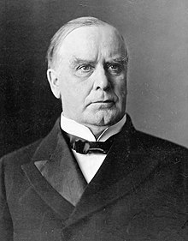
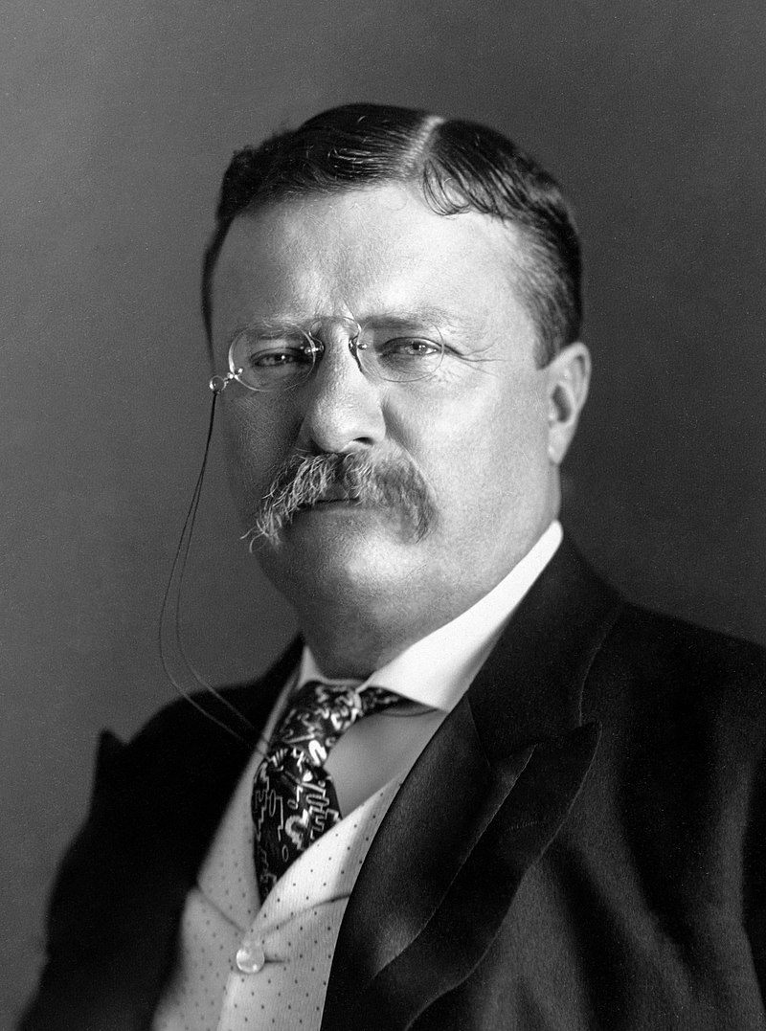
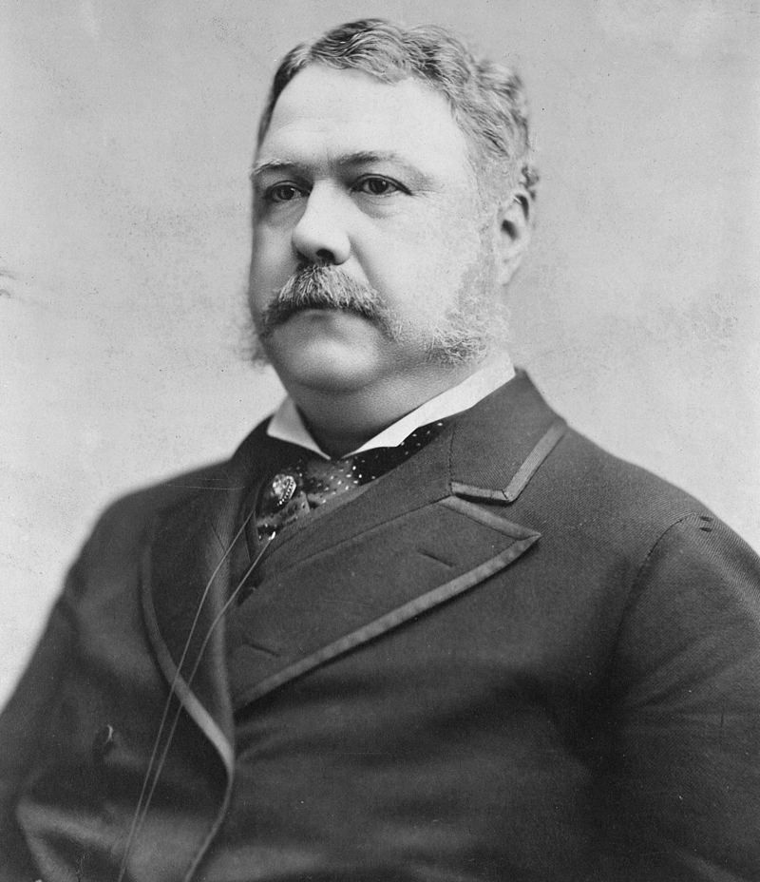
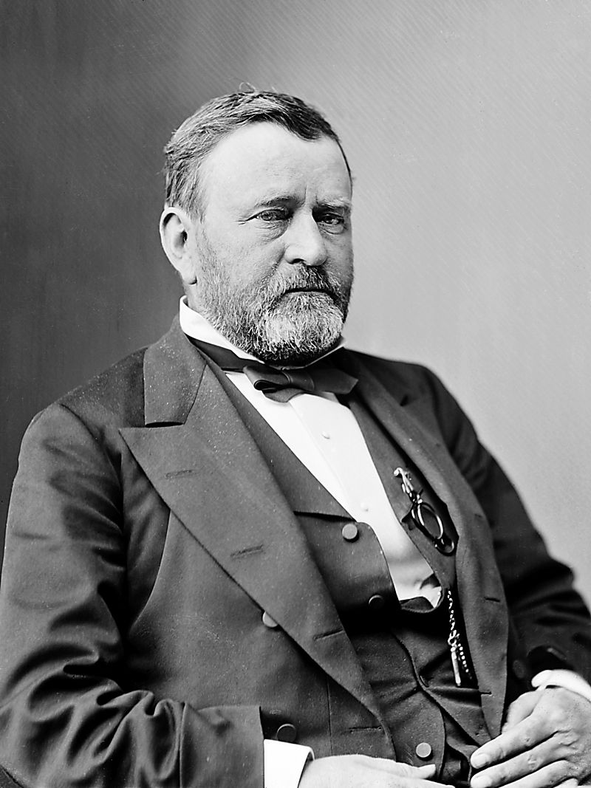
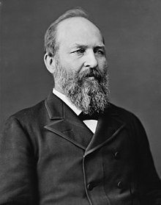
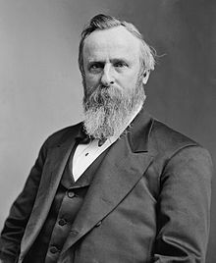
Pre-World War I Economics
France and Great Britain also had designs on their own welfare states prior to World War I.
The United States recovering from their Civil War (1860-1865) opted for a lassez faire economic policy under Republicans: Ulysses Grant, Rutherford Hayes, James Garfield, Chester Arthur, Benjamin Harrison, William McKinley, Teddy Roosevelt, and William Howard Taft.

Slide 32
Pre-World War I Economics
When the Democratic Party did win the Presidency in 1892, President Grover Cleveland found himself in the midst of the Panic of 1893. He handled it badly by having Congress repeal the Sherman Silver Purchase Act, which degraded the dollar.
The upheaval was worldwide as other countries were also debasing their currencies as well.
William McKinley came into office in 1897 and put in policies to strengthen the dollar. Theodore Roosevelt continued those policies.

Slide 33
Pre-World War I Economics
In the early 20th century, many countries became Welfare States, adopting old-age pensions, disability pensions, and other social welfare programs. The excess government spending caused their currencies to inflate.
When political tensions rose in 1914 due to the assassination of Archduke Ferdinand of Austria in Serbia, entangling alliances caused Austria-Hungary, Germany, Russia, France, and Great Britain to go to war. With the European economies doing badly, incentives to go to war were increased.
The United States stayed out of the War until 1917 and did not send soldiers to Europe until early 1918.

Slide 34
The Aftermath of World War I
Hyper-inflation riddled the economies of the Central Powers (Austria-Hungary, Germany, Ottoman Empire) upending their monarchies, replacing them with Socialist “Democracies.”
Great Britain maintained and improved their wealth thanks to their colonial gains in the Middle East and in Africa. They maintained a careful monetary policy, especially when the Tories (Conservative) Party was in power.
France continued their economic decline which started under Louis Napoleon III. The adopted their Welfare State shortly after Germany did.

Slide 35
The Aftermath of World War I
France’s Economy stagnated as they had a lot of rebuilding to do after the war. Germany’s reparations helped their economy as did help from Great Britain and the United States.
President Woodrow Wilson had a stroke causing the presidency to be stymied for almost two years. He did not participate in the election of 1920, opting not to run. Warren Harding won in a landslide.

Slide 36
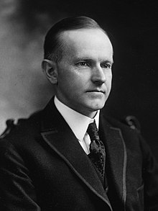
The Aftermath of World War I
President Warren Harding campaigned on a platform of “Return to Normalcy” taking the United States out of the League of Nations and staying out of European Affairs.
When the Panic of 1920 hit the stock market, President Harding instructed his Treasury Secretary: Andrew Mellon to leave things alone. He was concerned that tampering with the economy would do more harm than good. The market recovered and flew high until 1929.
When President Harding died, President Calvin Coolidge took over and stayed until 1929. He continued the policies of the Harding Administration.

Slide 37
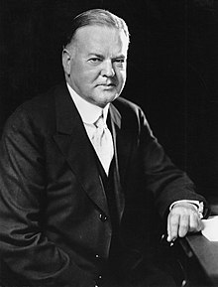
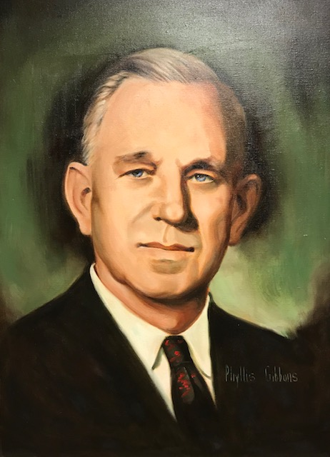
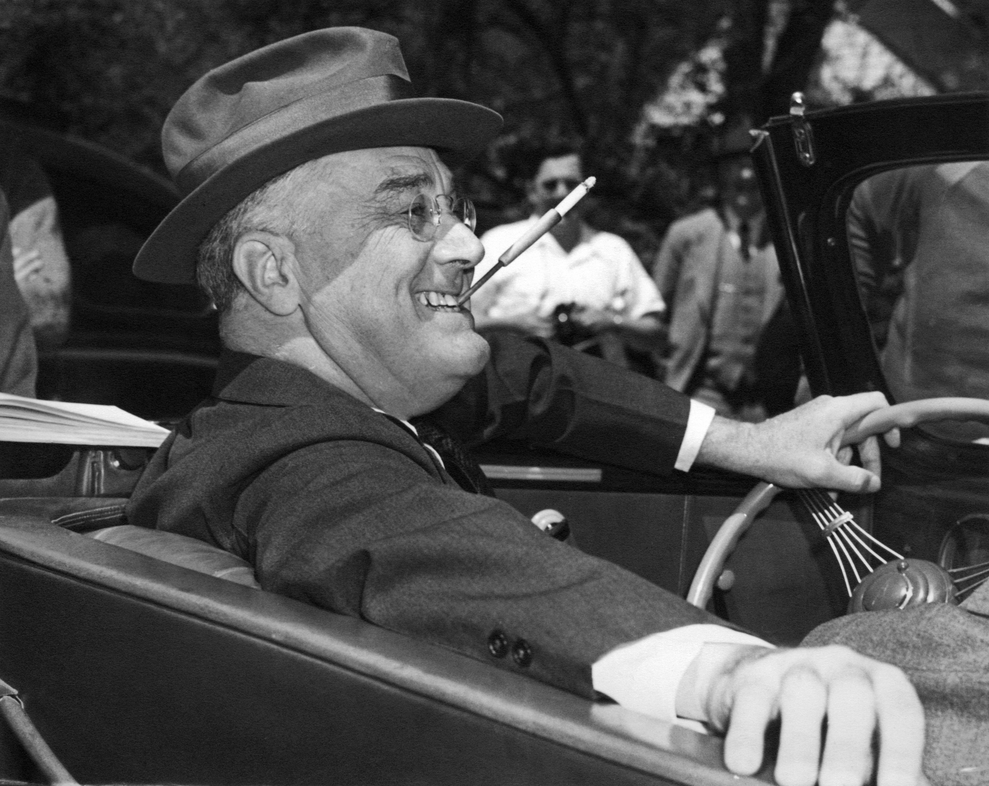
The Aftermath of World War I
When Calvin Coolidge decided that being in the White House for ten years was too long, the Republicans nominated Herbert Hoover in 1928. He won in a landslide thanks to the fact that Alfred Smith was a Roman Catholic. Many Protestant Churches, led by early Baptist megachurch Pastor J. Frank Norris campaigned heavily against Alfred Smith.
He was more interventionist than his predecessors, but the Great Depression doomed him. Rising interest rates “crashed” the stock market and European social issues carried over to the United States.
FDR for intents and purposes was America’s first socialist president.

Slide 38
The Pre-World War II Economy
In the late 1920s, the world economy was rocked by rising interest rates in Central Europe. The new central banks saw inflation coming and raised interest rates in an attempt to curb the growth of their money supply.
By 1929, Europe’s financial troubles translated to Great Britain and the United States. The Wall Street Crash came because the Federal Reserve Banks raised interest rates too quickly, causing credit to dry up, forcing owners of stock to sell their shares into a market full of sellers with no buyers.
The Central Banks raised interest rates too quickly causing a credit squeeze. If our current Federal Reserve continues to raise interest rates too quickly, we will see a crash like what we saw in 1929.

Slide 39
Thank You
Tom Mack and Tom Baird
media@aliveontheedge.com
http://aliveontheedge.com

