Slide 1
The Second Horse of the Apocalypse - Famine
Part X

Slide 2
Drought
The Battle to Starve America

Slide 3
The Summer of Drought
And when he had opened the fourth seal, I heard the voice of the fourth beast say, Come and see.
And I looked, and behold a pale horse: and his name that sat on him was Death, and Hell followed with him. And power was given unto them over the fourth part of the earth, to kill with sword, and with hunger, and with death, and with the beasts of the earth. (Revelation 6:7-8 AV, Cambridge Edition 1769)

Slide 4
The Summer of Drought
Pale – χλωρός - chlōros – [Strong’s #G5515]
(Strong’s) greenish, that is, verdant, dun-colored: - green, pale.
(Thayer) green, yellowish pale
(Mounce) pale green, green, verdant (green), Mark 6:39, Revelation 8:7, 9:4, pale, sallow (of a sickly, yellowish or lightish brown color), Revelation 6:8.
We get our words Chlorophyl, Chloroform, etc. from this word.
Total KJV Occurrences: 4
Green – 3 (Mark 6:39, Revelation 8:7, 9:4)
Pale – 1 (Revelation 6:8)

Slide 5
The Summer of Drought
Death – θάνατος – thanatos – [Strong’s #G2288]
(Strong’s) death (literally or figuratively): - X deadly, (be...) death.
Total KJV Occurrences: 118
Death – 115
Deadly – 2
Deaths - 1

Slide 6
The Summer of Drought
Death – θάνατος – thanatos – [Strong’s #G2288]
(Thayer) the death of the body
1a) that separation (whether natural or violent) of the soul and the body by which the life on earth is ended
1b) with the implied idea of future misery in hell
1b1) the power of death
1c) since the nether world, the abode of the dead, was conceived as being very dark, it is equivalent to the region of thickest darkness, i.e. figuratively, a region enveloped in the darkness of ignorance and sin

Slide 7
The Summer of Drought
Death – θάνατος – thanatos – [Strong’s #G2288]
(Thayer) the death of the body:
2) metaphorically, the loss of that life which alone is worthy of the name
2a) the misery of the soul arising from sin, which begins on earth but lasts and increases after the death of the body in hell
3) the miserable state of the wicked dead in hell
4) in the widest sense, death comprising all the miseries arising from sin, as well physical death as the loss of a life consecrated to God and blessed in him on earth, to be followed by wretchedness in hell

Slide 8
The Summer of Drought
Death – θάνατος – thanatos – [Strong’s #G2288]
(Mounce) 120x: death,
the extinction of life, whether naturally, (Luke 2:26, Mark 9:1) or violently, (Matthew 10:21, Matthew 15:4)
imminent danger of death, (II Corinthians 4:11-12, 23)
in NT spiritual death, as opposed to ζωή in its spiritual sense,
in respect of a forfeiture of salvation, (John 8:51, Romans 6:16)

Slide 9
The Summer of Drought
Hell - ᾅδης - hadēs – [Strong’s #G86]
(Strong’s) properly unseen, that is, “Hades” or the place (state) of departed souls: - grave, hell.
Thayer
name Hades or Pluto, the god of the lower regions
Orcus, the nether world, the realm of the dead
later use of this word: the grave, death, hell

Slide 10
The Summer of Drought
Hell - ᾅδης - hadēs – [Strong’s #G86]
(Mounce) the invisible abode or mansion of the dead;
the place of punishment,
hell;
the lowest place or condition. (Matthew 11:23, Luke 10:15)

Slide 11
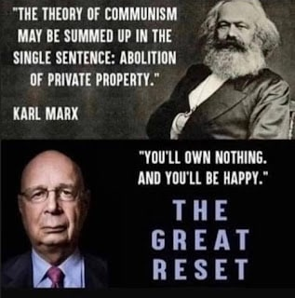
Creeping Socialism

Slide 12
The Summer of Drought
The World Economic Forum’s Directive for Decades has been to Reduce the World’s Population to “Sustainable Levels.”
The World Economic Forum accomplished this by Inciting a War between Russia and Ukraine. Here is how they did it:
They used the Obama Administration to incite a revolution in Ukraine to bring in a government favorable to the West and especially the World Economic Forum.
Once they established power, they weaponized Ukraine with Western Military Goods and installed “military advisors” to help the Ukrainians build up their military.

Slide 13
The Summer of Drought
The World Economic Forum’s Directive for Decades has been to Reduce the World’s Population to “Sustainable Levels.”
The World Economic Forum accomplished this by Inciting a War between Russia and Ukraine. Here is how they did it:
They also bribed Ukrainian leaders to allow them to Place Bio-Labs in the Country.
Russia vehemently protested these moves into Ukraine through diplomatic channels. Eventually, the Minsk Agreements were signed, first in September of 2014 and again on February 12, 2015. The Ukraine government disdained the agreement even though they signed it.

Slide 14
The Summer of Drought
The World Economic Forum’s Directive for Decades has been to Reduce the World’s Population to “Sustainable Levels.”
The World Economic Forum accomplished this by Inciting a War between Russia and Ukraine. Here is how they did it:
The Russians worked through diplomatic channels to get the parties to the treaty to follow it. The Trump Administration even cut off most aid to Ukraine at the request of Putin and the Russian Government because of the Treaty Violations.
The Russians were convinced by the Trump Administration to stand down their military and continue to use diplomatic means to solve the disputes.

Slide 15
The Summer of Drought
The World Economic Forum’s Directive for Decades has been to Reduce the World’s Population to “Sustainable Levels.”
The World Economic Forum accomplished this by Inciting a War between Russia and Ukraine. Here is how they did it:
Changes came when Joe Biden was “elected” president and inaugurated in January of 2021. They immediately restarted all aid to Ukraine and began to send even more military equipment. When the Ukraine government started a program to exterminate ethnic Russian in the Donbas Region.
When Russia moved to protect their interests, the EU “sanctioned” Russia. Now, the world lacks the fertilizer needed to grow their crops. Even worse, the EU now lacks the energy resources once supplied by Russia to maintain their industry.

Slide 16
The Summer of Drought
The World Economic Forum’s Directive for Decades has been to Reduce the World’s Population to “Sustainable Levels.”
The World Economic Forum accomplished this by Inciting a War between Russia and Ukraine. Here is how they did it:
Couple this with droughts caused by HAARP and other technologies, we are headed for trouble.

Slide 17
The Summer of Drought
The Federal Bureau of Investigation (FBI) is informing Food and Agriculture (FA) sector “partners” that ransomware actors may be more likely to attack agricultural cooperatives during critical planting and harvest seasons, disrupting operations, causing financial loss, and negatively impacting the food supply chain.
Although ransomware attacks against the entire farm-to-table spectrum of the FA sector occur on a regular basis, the number of cyber attacks against agricultural cooperatives during key seasons is notable.
https://www.ic3.gov/Media/News/2022/220420-2.pdf

Slide 18
The Summer of Drought
Since 2021, multiple agricultural cooperatives have been impacted by a variety of ransomware variants. Initial intrusion vectors included known but unpatched common vulnerabilities and exploits, as well as secondary infections from the exploitation of shared network resources or compromise of managed services.
A significant disruption of grain production could impact the entire food chain, since grain is not only consumed by humans but also used for animal feed. In addition, a significant disruption of grain and corn production could impact commodities trading and stocks.
https://www.ic3.gov/Media/News/2022/220420-2.pdf

Slide 19
The Summer of Drought
In July 2021, a business management software company found malicious activity on its network, which was later identified as HelloKitty/Five Hands ransomware. The threat actor demanded $30 million USD ransom. The ransomware attack on the company led to secondary ransomware infections on a number of its clients, which included several agricultural cooperatives.
Between 15 September and 6 October 2021, six grain cooperatives experienced ransomware attacks. A variety of ransomware variants were used, including Conti, BlackMatter, Suncrypt, Sodinokibi, and BlackByte. Some targeted entities had to completely halt production while others lost administrative functions.
https://www.ic3.gov/Media/News/2022/220420-2.pdf

Slide 20
The Summer of Drought
This warning comes as an increasing number of events of fires and explosions have been reported at food processing facilities across the country recently featured during a segment on Fox News’s Tucker Carlson Tonight:
Fri Aug 9, 2019 Tyson Foods, Inc. Holcomb, KS Fire
Tue Jan 12, 2021 Deli Star Meat Plant Fayetteville, IL Fire
Sun July 25, 2021 Kellogg Company Memphis, TN Fire
Tue Aug 24, 2021 Patak Meat Proc. Cobb County, GA Fire
Mon Sept 13, 2021 JBS, USA Grand Island, NE Fire
Sat Nov 20, 2021 Maid-Rite Steak Co. Kansas City, KS Fire

Slide 21
The Summer of Drought
Sun Dec 12, 2021 West Side Processing Plant San Antonio, TX Fire
Sat Jan 1, 2022 Van Drunen Farms Momence, IL Fire
Fri Jan 14, 2022 Cargill Nutrena Feed Mill Lecompte, LA Explosion
Fri Jan 21, 2022 Potato Plant Warden, WA Fire
Tue Feb 1, 2022 Harper’s Market Poultry Plant Ham. Mtn., WA Fire
Thu Feb 3, 2022 Wisconsin River Meats Mauston, WI Fire
Tue Feb 15, 2022 Bonanza Company El Paso, TX Fire
Mon Feb 25, 2022 Shearer’s Food Hermiston, OR Explosion
Sun Mar 13, 2022 Hot Pockets Plant Jonesboro, AR Fire

Slide 22
The Summer of Drought
Wed Mar 16, 2022 Walmart Fulfillment Center Plainfield, IN Fire
Mon Mar 28, 2022 Maricopa Food Pantry Phoenix, AZ Fire
Thu Mar 31, 2022 Rio Fresh San Juan, TX Fire
Mon April 11, 2022 East Conway Beef and Pork Conway, NH Fire
Wed April 13, 2022 Gem State Processing Heyburn, ID Plane Crash
Wed April 13, 2022 Taylor Farms Salinas, CA Fire
Mon April 18, 2022 Azure Standard Headquarters Dufur, OR Fire

Slide 23
The Summer of Drought
Thu April 21, 2022 General Mills Covington, GA Plane Crash
Sat April 30, 2022 Perdue Farms Chesapeake, VA Fire
Wed May 11, 2022 BioUrja Grain Silos Peoria, IL Explosion
Sat May 28, 2022 Forsman Farm Howard Lake, MN Fire
Tue June 7, 2022 JBS Foods Green Bay, WI Fire

Slide 24
The Summer of Drought

Slide 25
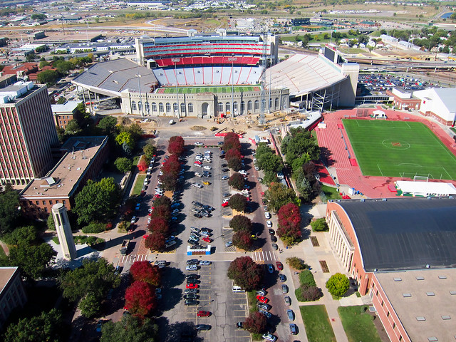
The Summer of Drought
However, it is important to understand how bad this drought has become in the United States. The University of Nebraska has continued to research this situation and releases drought maps on the Internet to keep everyone apprised of the situation.

Slide 26
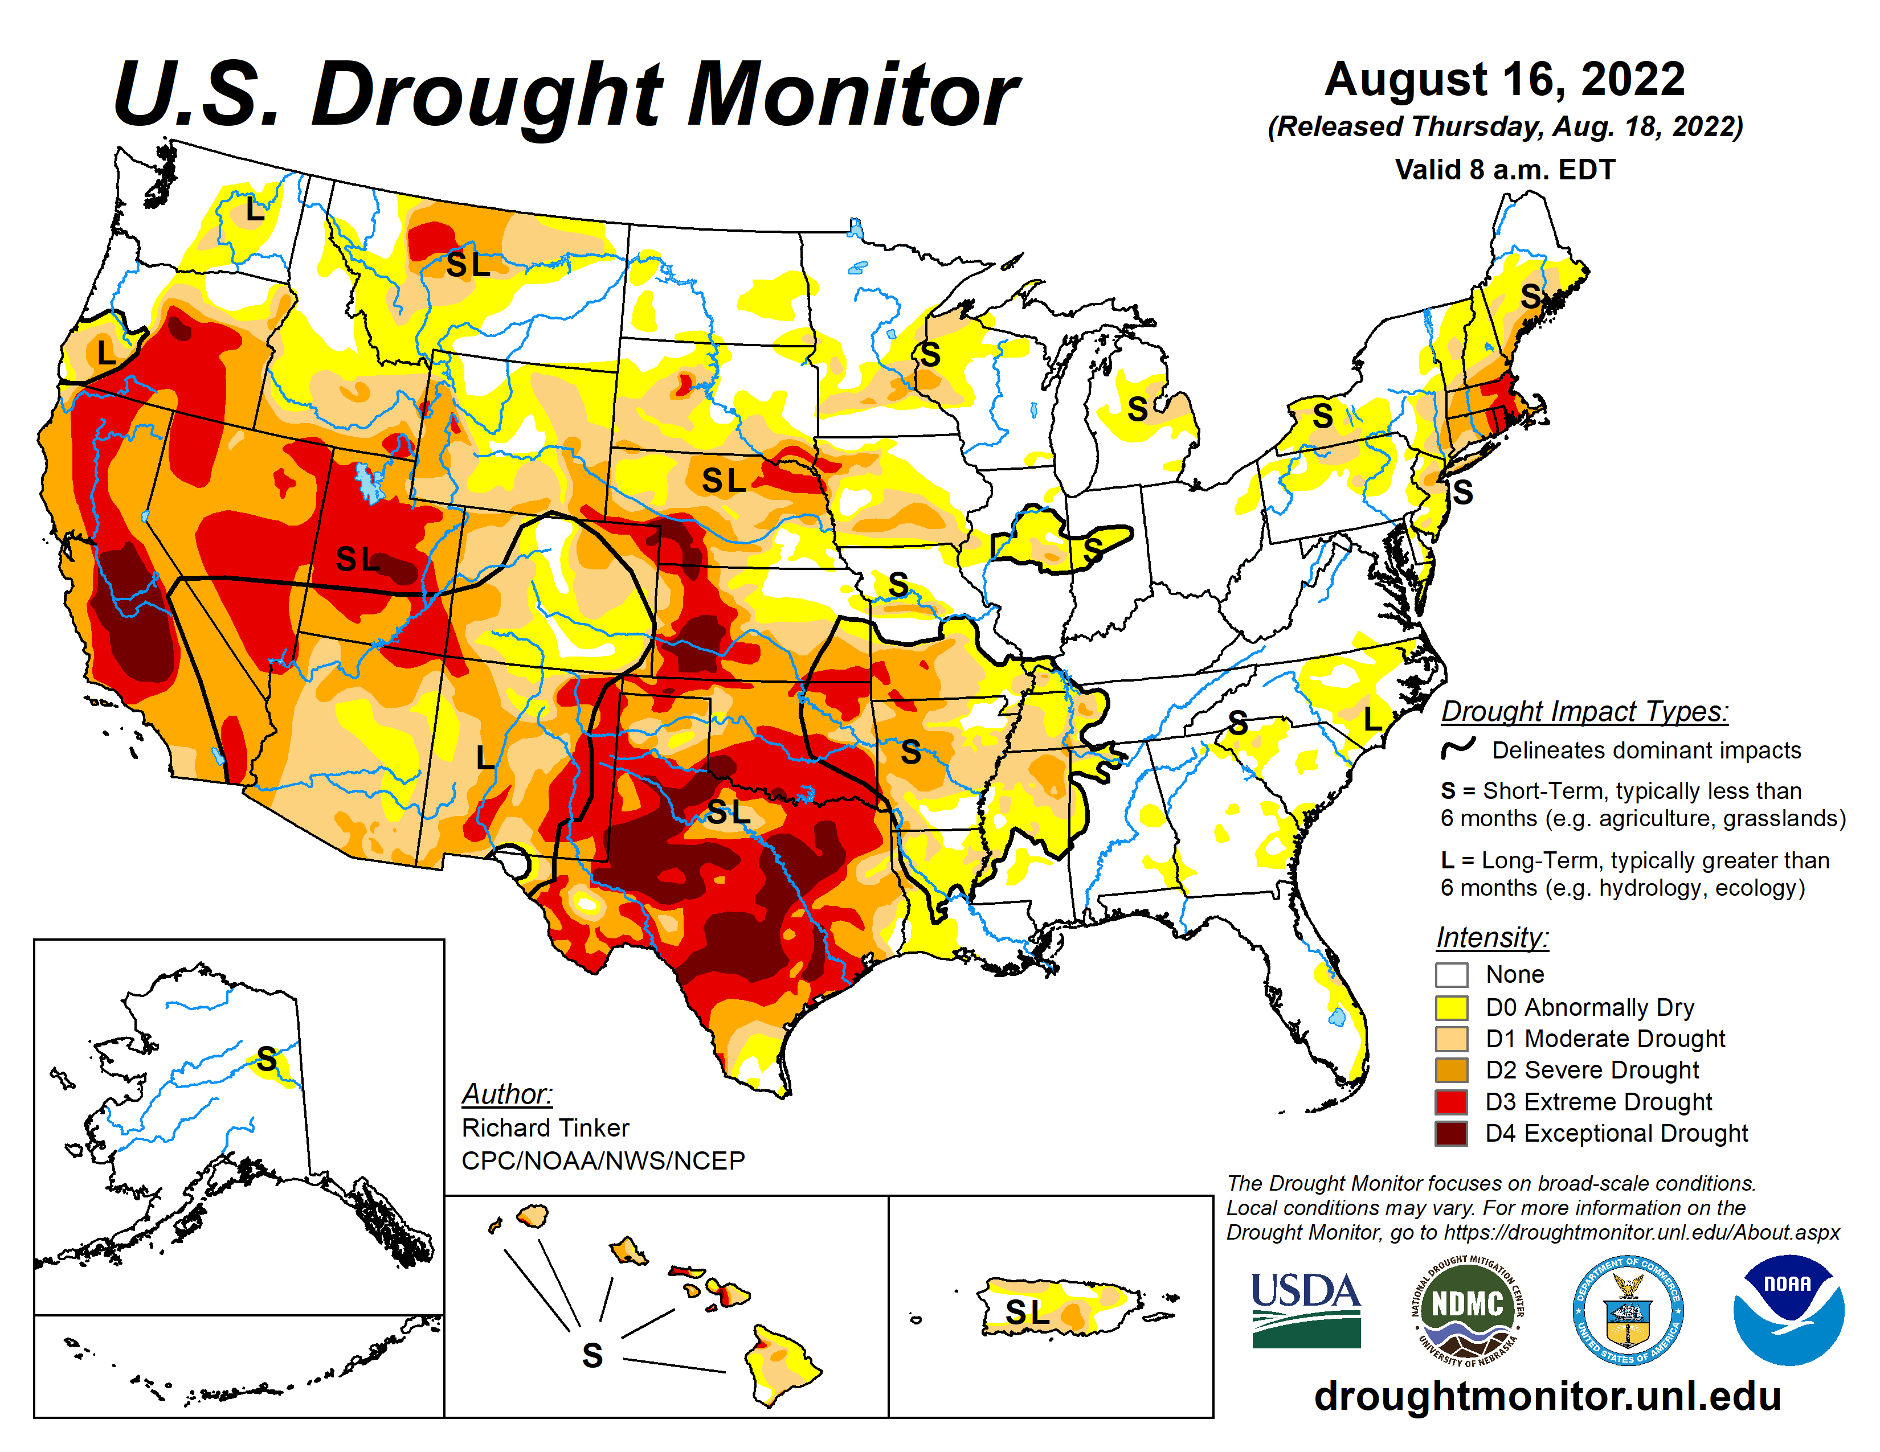

Slide 27
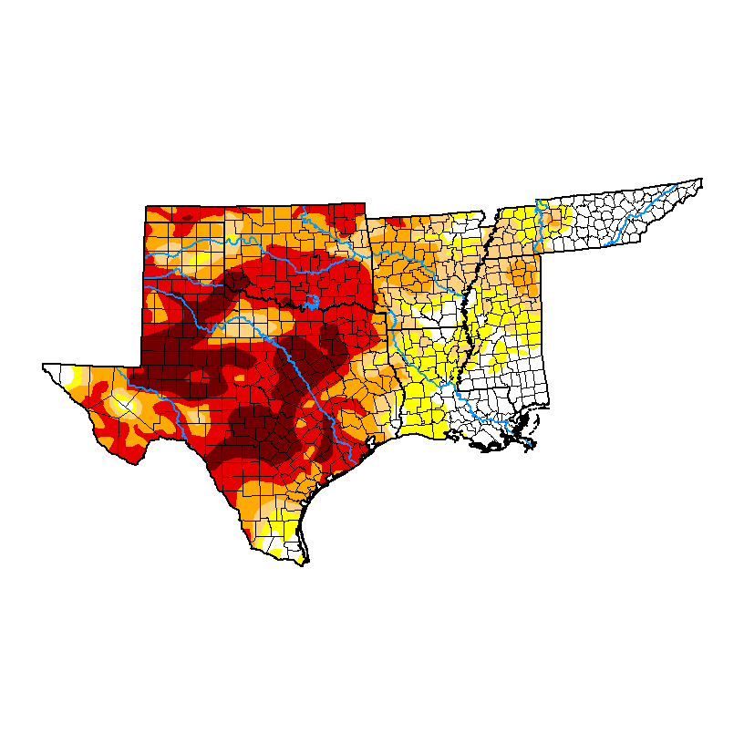

Slide 28
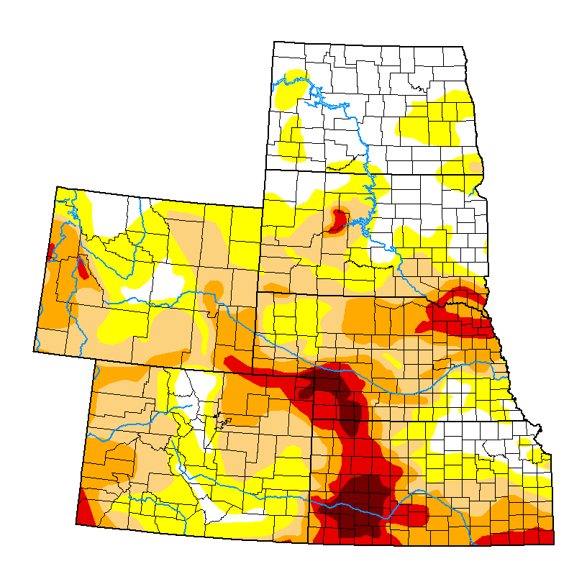

Slide 29
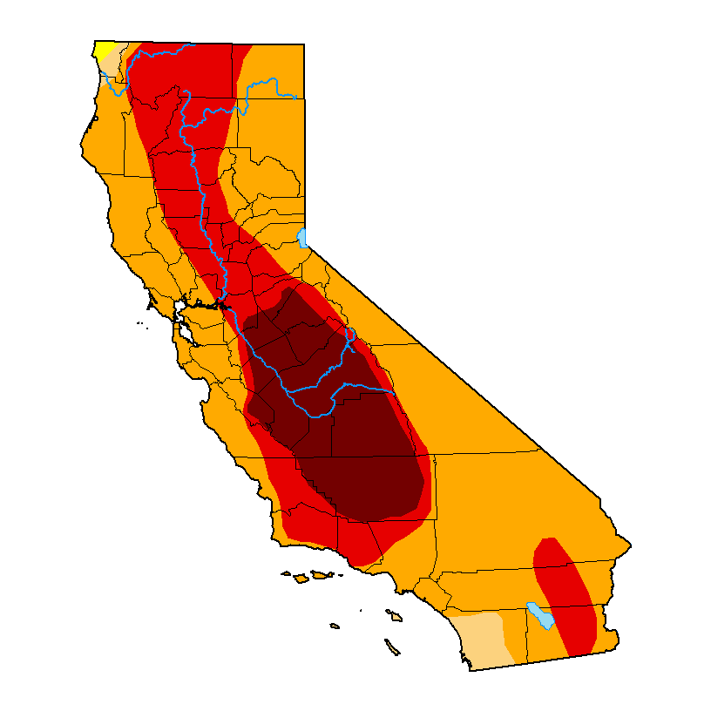

Slide 30
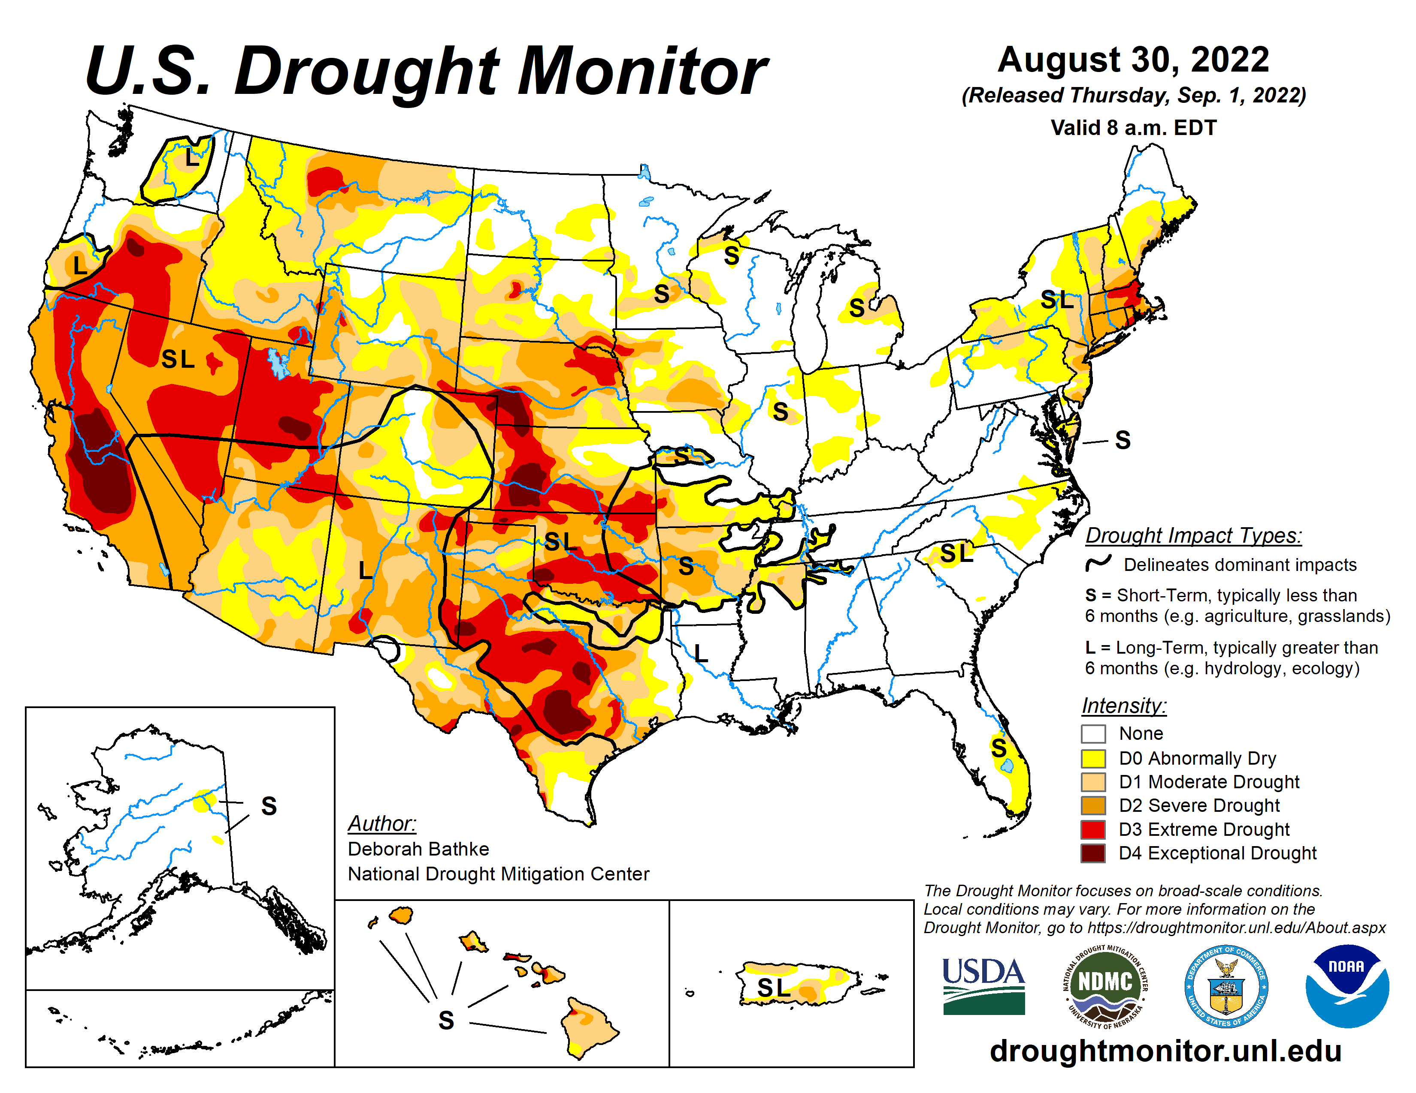

Slide 31
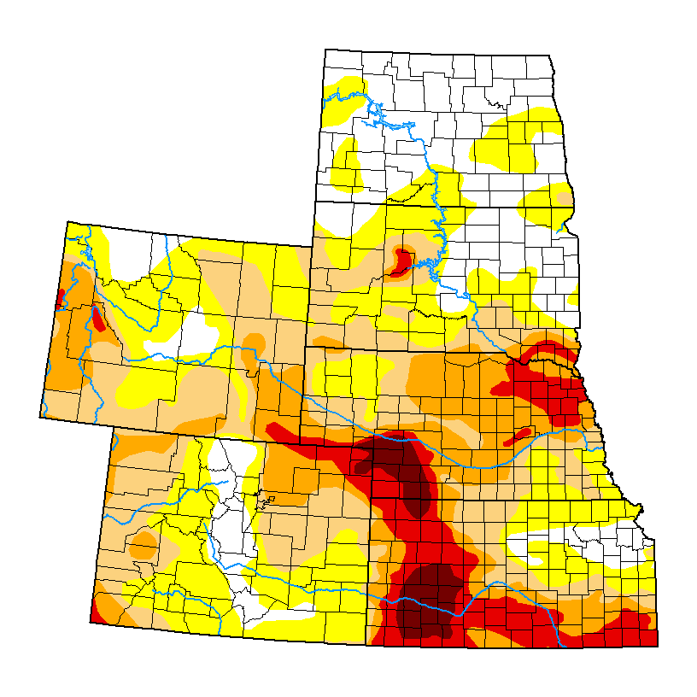

Slide 32
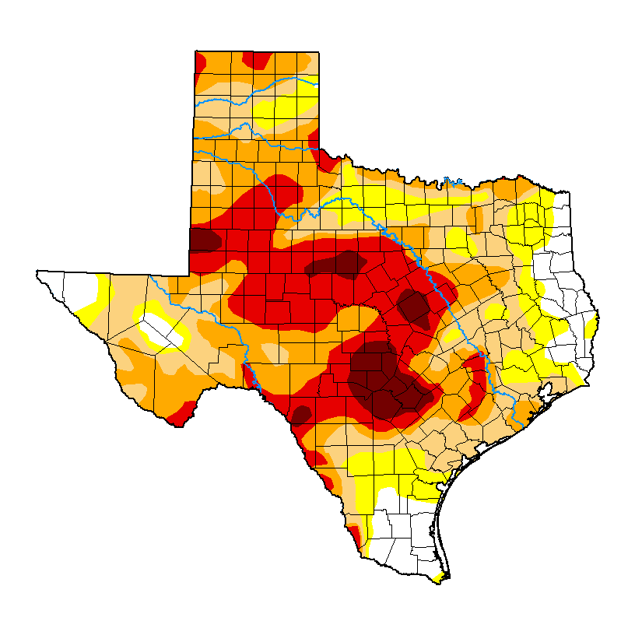

Slide 33
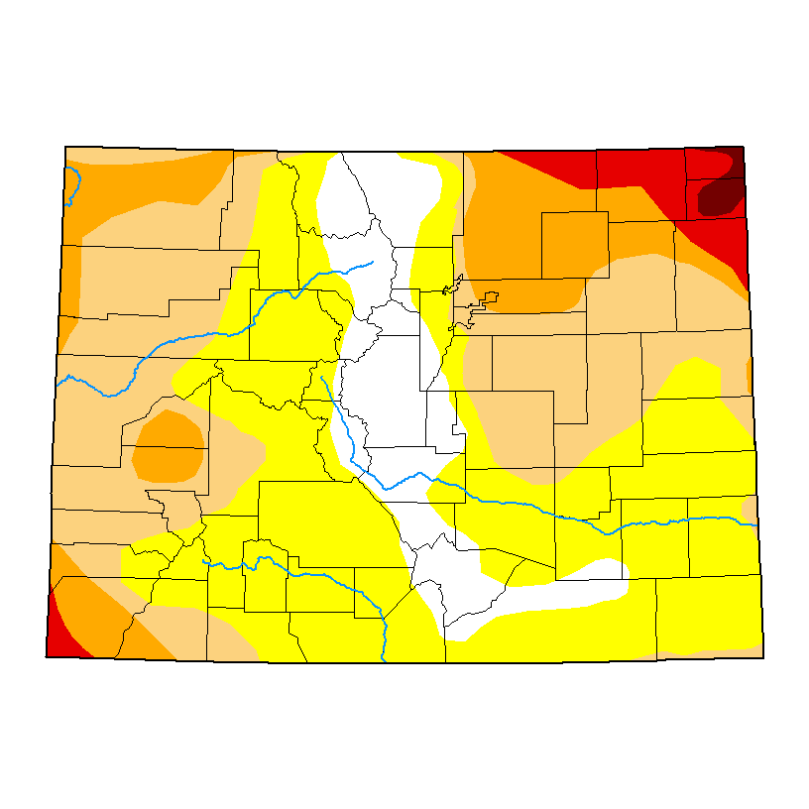

Slide 34
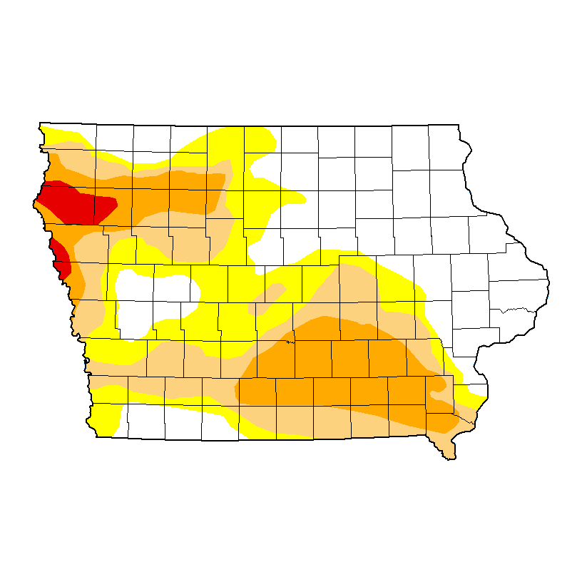

Slide 35
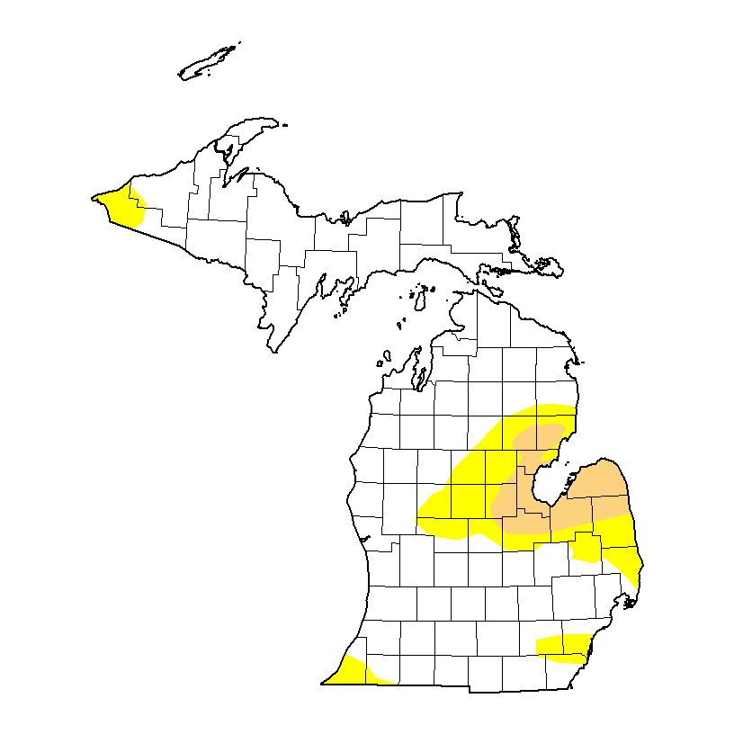

Slide 36
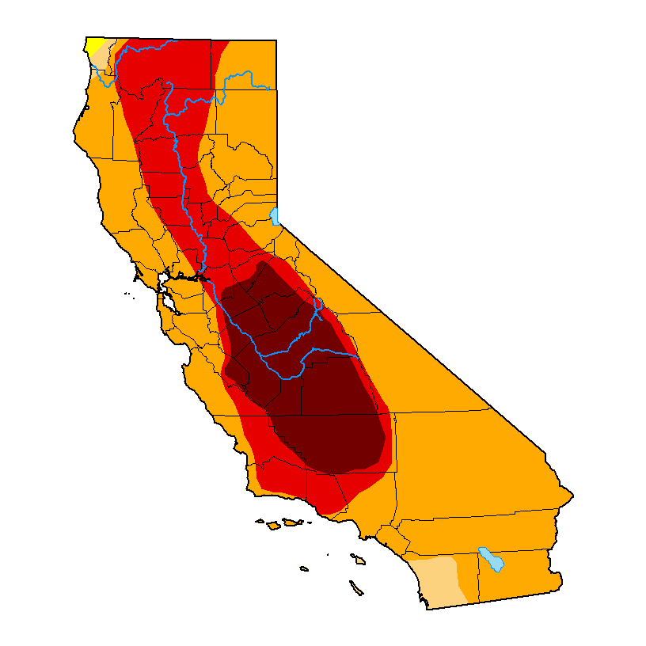

Slide 37
Bible Music Research
In anticipation of a trip to Heavener, Oklahoma later this summer, we did some more experimentation with our Bible Music Project.
Much of the research we previously did is on our website: http://biblemusic.live.
Much of that work from 2006-2012 centered around weather research and culminated with making it rain every day in June of 2012 in Trinidad, Colorado. Professor Mack was assisted by the late scientist: Olaf H. Hage III and Sound Engineer Chris Blodgett, both in the construction of the music and in the scientific elements.
On July 4, 2022, we embarked on a new project. In our first phase, we made music from Isaiah 9:8 to 13:33 in all 12 key signatures. We played the music out into the atmosphere for the first time that evening. Areas of drought suddenly got rain, but CERN did not operate as planned and there was a problem with the Georgia Guidestones.

Slide 38
Bible Music Research
In anticipation of a trip to Heavener, Oklahoma later this summer, we did some more experimentation with our Bible Music Project.
On July 22, 2022, I went to Colorado Springs, Colorado on personal business. While waiting in a waiting room at Memorial Hospital, I learned on local television that the city had experienced greater than average temperatures on 18 of 21 days on the month. They only had rain on three of those days.
Since I had “Rain Machine” on my phone, I started playing it in the waiting room of the Hospital. Within two hours of playing it, the clouds came off the mountain and it started raining heavily.

Slide 39
Bible Music Research
In anticipation of a trip to Heavener, Oklahoma later this summer, we did some more experimentation with our Bible Music Project.
In a follow-up to the Colorado Springs events, we noticed that the rain system missed Trinidad, Colorado. It is something that we have seen before. Even the late Stephen Hamer, M.S. (Meteorology) could not account for or explain the number of times that storm systems bypassed Trinidad, Colorado.
This time, we played Zechariah, chapters 13-14 into the air. Within two hours, thunderstorms came over the mountains and continued for much of the night.
Continuous thunderstorms are rare in Trinidad, Colorado, as the city is on the Northeast corner of the Great Southwestern Desert of the United States.

Slide 40
WhiteStone Foundation Music Research
In anticipation of a trip to Heavener, Oklahoma later this summer, we did some more experimentation with our Bible Music Project.
Bible Music for Isaiah 9:8 – 13:22. MP3 File.
Bible Music for Zechariah 13-14. MP3 File.
Bible Music for Zechariah 13-14. FLAC File.
Here is the key verse:
In that day there shall be a fountain opened to the house of David and to the inhabitants of Jerusalem for sin and for uncleanness. (Zechariah 13:1)
We are getting ready to post additional scriptures. If some of you have suggestions for scriptures to render into music, let us know. tom.mack@whitestonefoundation.org.

Slide 41
WhiteStone Foundation Music Research
You can follow our most recent research on our Telegram Channel:
https://t.me/Bible_Music1
Our Website for this music is:
http://biblemusic.live

Slide 42
WhiteStone Foundation Music Research
You can follow our most recent research on our Telegram Channel:
https://t.me/Bible_Music1
Our Website for this music is:
http://biblemusic.live

Slide 43
Websites
Major Tom Baird (ret.)
http://aliveontheedge.com
http://copperscrollincident.info
Email: tom@aliveontheedge.com
Telegram Channel: https://t.me/aliveontheedge

Slide 44
Websites
Prof. Tom Mack (ret.)
Websites:
http://whitestonefoundation.org
http://biblecodes.co
http://biblemusic.live
http://whitecottagepublishing.com
http://jonvanhelsing.com
http://ancient-evil.org
http://warfareprayers-book.com
http://heavenermysteries.info
http://antichristwatch.org
http://thetimequest.com
http://whitestonetechnologies.co
Telegram Channel:
https://t.me/Bible_Music1
Email:
tom.mack@whitestonefoundation.org

