Slide 1
The Greater Exodus
Part I

Slide 2
Key Scriptures
The secrets of Yahuah Elohaynu (A.V, “LORD our God”) are given to his children and their sons forever and ever, that they may observe every word of the Torah. (Deuteronomy 29:29)

Slide 3
The Beginnings of the Third Exodus Teaching
Teachings regarding the Third Exodus have been around for centuries.
At the Beginning of the Second Century, the Phiabi Family began a program to bring all the Jews back to the Promised Land. Much of this was done by force, causing many to leave their homes, unwillingly.
The Bar Kokhba Revolt in A.D. 132-135 ended this effort, as the Jews lost their war to the Romans and their temple was burned down and replaced by a temple to Jupiter.

Slide 4
The Beginnings of the Third Exodus Teaching
Teachings regarding the Third Exodus have been around for centuries.
When Constantine issued his Edict of Toleration in A.D. 311, the Jews saw this edict as an approval of their desire to again rebuild the Temple.
The Phiabis then hired Levites to begin the process of building the Temple.
Constantine, fearing that the building of a Jewish Temple would lead to a revolt, cut off the ears of the Levites. The work on the Temple stopped.

Slide 5
The Beginnings of the Third Exodus Teaching
Teachings regarding the Third Exodus have been around for centuries.
In 1666, a Jewish Anti-Messiah named Sabbati Zevi was in the middle of a movement that wanted to re-establish a Jewish kingdom in the Promised Land.
The Turkish Sultan Mehmed IV captured him and gave him three choices for his treasonous activities:
A Trial of his Divinity (three archers would shoot arrows at him, if the arrows missed, they would consider his claims)
He could be impaled.
He could convert to Islam.

Slide 6
The Beginnings of the Third Exodus Teaching
Teachings regarding the Third Exodus have been around for centuries.
In the 19th century, Labor Zionism started to become popular. However, they believed they could take the Promised Land without the help of YHWH.
The key writing was a pamphlet titled Der Judenstaat (The Jewish State) by Theodor Herzl published in 1896. Mr. Herzl proposed the creation of a Jewish state in response to the Jewish Progroms in Russia and the Ottoman Empire. This would give Jews a place to run to when their home countries persecuted them.
At the end of the 19th century, most Jews were forced to live in ghettos to defend themselves.

Slide 7
The Beginnings of the Third Exodus Teaching
Teachings regarding the Third Exodus have been around for centuries.
In 1917, after the British drove out the Ottoman Empire in the “Battle of Armageddon,” The Balfour Declaration was issued. The declaration was written to Baron Rothchild.
Afterward, the Labor Zionist movement promoted Jewish immigration to Israel. Many Jews from Great Britain and Western Europe resettled in the Promised Land under the British Mandate.
That program stopped when the British government issued their White Paper of 1939.

Slide 8
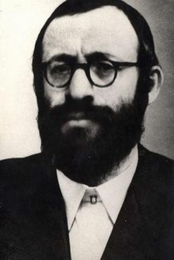
Things are NOT as They Seem!
Not all religious Jews agreed with the Labor Zionist Movement.
Rabbi Michael Dov Weissmandl (1903-1957) and other Orthodox Jews argued that the Labor Zionist’s settlement of the Promised Land after World War I was NOT the prophetic return taught in the Torah and the Tenach.
He argued that when Israel does return to the Promised Land, that return would be a Divine intervention! It would NOT be something done by human effort.

Slide 9
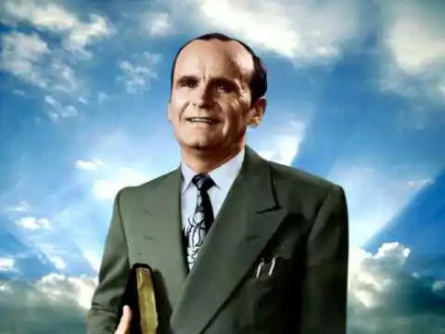
Things are NOT as They Seem!
The Orthodox Jewish teachings also reached into the Christian world:
William Marion Branham (1909-1965) preached a curious sermon titled “The Third Exodus” on June 30, 1964, at his home church in Jeffersonville, Indiana.
However, on December 4, 1965, just 20 days before he would die from injuries, he sustained in a car crash several days before, he preached a sermon titled “The Rapture” at a FGBMI Meeting in Yuma, Arizona. It did not refute his earlier sermon, but seemed to support the teachings of Dallas Theological Seminary.

Slide 10
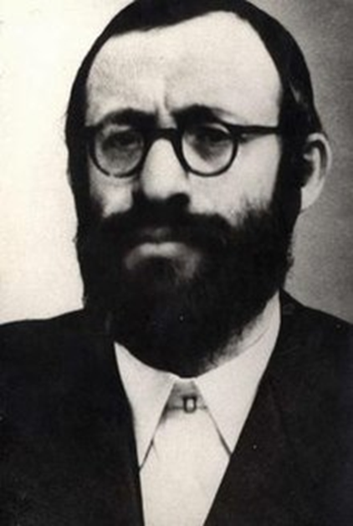
Things are NOT as They Seem!
These voices were very limited:
Rabbi Weissmandl died in 1957 and was in poor health prior to his death. The only reason we know much about him is because his Yeshiva students took his work to Israel and published a lot of it there.
William Branham changed his message to match the “rapture” doctrines Dallas Theological Seminary was beginning to promulgate. It is not known if he ever talked about a Third Exodus again after 1963.

Slide 11
Things are NOT as They Seem!
Western intelligence services have extensively studied the Bible and became aware of the Third Exodus teachings. They saw those teachings as a threat to their Socialist concepts of a New World Order.
In 1958, the liberal Brookings Institution wrote an article in one of their publications stating that they needed to change the theological thinking in Conservative Christian Church organizations.
The Brookings Institution has been identified by multiple observers as a participant in the CIA’s infamous program Operation Mockingbird.

Slide 12
Things are NOT as They Seem!
Using Operation Mockingbird, the CIA began to study the Bible and history to rewrite doctrine for the conservative church organizations. It is likely they accepted a lot of help from the Jesuits and the Phiabis, who understood these teachings.
The CIA started funding various publication projects by seminary professors and their own selected authors.
Their big breakthrough came in 1970 with the publication of The Late Great Planet Earth by Hal Lindsey.

Slide 13
Things are NOT as They Seem!
Lindsey’s book introduced the mainstream of Conservative Christianity to the following doctrines:
Political Zionism (Israeli Government “Right or Wrong”)
They wanted to obscure Rabbi Weissmandl’s teachings
The Advent of an “Antichrist” World Leader
The Pre-Tribulation Rapture Doctrine

Slide 14
The Teachings of the Greater Exodus
The Rabbis and Sages frequently taught of a time where the Israelites would be regathered from every part of the world and brought back to Israel.
There, they would rule and reign with the Messiah for the rest of time.
Are these Jewish fables or are they based upon the teachings of scripture?

Slide 15
The Foundations of the Greater Exodus
Like all Biblical Doctrines, their start is in the Torah.
Moses knew the heart of the Israelites very well.
And if ye will not for all this hearken unto me, but walk contrary unto me;
Then I will walk contrary unto you also in fury; and I, even I, will chastise you seven times for your sins.
And ye shall eat the flesh of your sons, and the flesh of your daughters shall ye eat.
And I will destroy your high places, and cut down your images, and cast your carcases upon the carcases of your idols, and my soul shall abhor you. (Leviticus 26:27-30)

Slide 16
The Foundations of the Greater Exodus
Like all Biblical Doctrines, their start is in the Torah.
Moses knew the heart of the Israelites very well.
And I will make your cities waste, and bring your sanctuaries unto desolation, and I will not smell the savour of your sweet odours.
And I will bring the land into desolation: and your enemies which dwell therein shall be astonished at it.
And I will scatter you among the heathen, and will draw out a sword after you: and your land shall be desolate, and your cities waste.
Then shall the land enjoy her Sabbaths, as long as it lieth desolate, and ye be in your enemies' land; even then shall the land rest, and enjoy her Sabbaths. (Leviticus 26:31-34)

Slide 17
The Foundations of the Greater Exodus
Like all Biblical Doctrines, their start is in the Torah.
Moses knew the heart of the Israelites very well.
If they shall confess their iniquity, and the iniquity of their fathers, with their trespass which they trespassed against me, and that also they have walked contrary unto me;
And that I also have walked contrary unto them, and have brought them into the land of their enemies; if then their uncircumcised hearts be humbled, and they then accept of the punishment of their iniquity:
Then will I remember my covenant with Jacob, and also my covenant with Isaac, and also my covenant with Abraham will I remember; and I will remember the land.
The land also shall be left of them, and shall enjoy her Sabbaths, while she lieth desolate without them: and they shall accept of the punishment of their iniquity: because, even because they despised my judgments, and because their soul abhorred my statutes. (Leviticus 26:40-43)

Slide 18
The Foundations of the Greater Exodus
Like all Biblical Doctrines, their start is in the Torah.
Moses knew the heart of the Israelites very well.
And yet for all that, when they be in the land of their enemies, I will not cast them away, neither will I abhor them, to destroy them utterly, and to break my covenant with them: for I am YHWH their Elohim.
But I will for their sakes remember the covenant of their ancestors, whom I brought forth out of the land of Egypt in the sight of the heathen, that I might be their Elohim: I am YHWH.
These are the statutes and judgments and laws, which YHWH made between him and the children of Israel in mount Sinai by the hand of Moses. (Leviticus 26:44-46)

Slide 19
The Principles of the Greater Exodus
When the Israelites are in the Promised Land,
if they commit gross iniquity,
refusing to repent,
they will be brought out of the land and
taken to another land.
There, they will suffer until they repent of their wickedness and
cry out for redemption.
YHWH will then bring them out of the other land back to the Promised Land.
Has this happened before???

Slide 20
The Principles of the Greater Exodus
Abraham left Ur of the Chaldees for the Promised Land taking his wife with him.
He would have a son Isaac who would in turn have Jacob.
Jacob would have 12 sons by four different wives.
All this happened in the Promised Land.

Slide 21
The Principles of the Greater Exodus
The 11th son was Joseph, but he was given the birthright because he was the son of Rachel, his favored wife.
Because he had prophetic gifts and a closer relationship to YHWH, the ten previous brothers resented and hated him.

Slide 22
The Principles of the Greater Exodus
Eventually, the ten brothers sold Joseph to Midianites who then sold him to the Egyptians. That was the wickedness!
When a famine came, Jacob and the 11 remaining sons were forced to resettle in Egypt.
Eventually, the Israelites were enslaved in Egypt and put in bondage 400 years.
When the Israelites called out to YHWH, He delivered them via The Exodus.

Slide 23
The Foundations of the Greater Exodus
Like all Biblical Doctrines, their start is in the Torah.
Moses knew the heart of the Israelites very well.
For YHWH thy Elohim is a consuming fire, even a jealous El.
When thou shalt beget children, and children's children, and ye shall have remained long in the land, and shall corrupt yourselves, and make a graven image, or the likeness of any thing, and shall do evil in the sight of YHWH thy Elohim, to provoke him to anger:
I call heaven and earth to witness against you this day, that ye shall soon utterly perish from off the land whereunto ye go over Jordan to possess it; ye shall not prolong your days upon it but shall utterly be destroyed.
And YHWH shall scatter you among the nations, and ye shall be left few in number among the heathen, whither YHWH shall lead you. (Deuteronomy 4:24-27)

Slide 24
The Foundations of the Greater Exodus
Like all Biblical Doctrines, their start is in the Torah.
Moses knew the heart of the Israelites very well.
And there ye shall serve elohim, the work of men's hands, wood and stone, which neither see, nor hear, nor eat, nor smell.
But if from thence thou shalt seek YHWH thy Elohim, thou shalt find him, if thou seek him with all thy heart and with all thy soul.
When thou art in tribulation, and all these things are come upon thee, even in the latter days, if thou turn to YHWH thy Elohim, and shalt be obedient unto his voice;
(For YHWH thy Elohim is a merciful El;) he will not forsake thee, neither destroy thee, nor forget the covenant of thy fathers which he sware unto them. (Deuteronomy 4:28-31)

